Slide 1
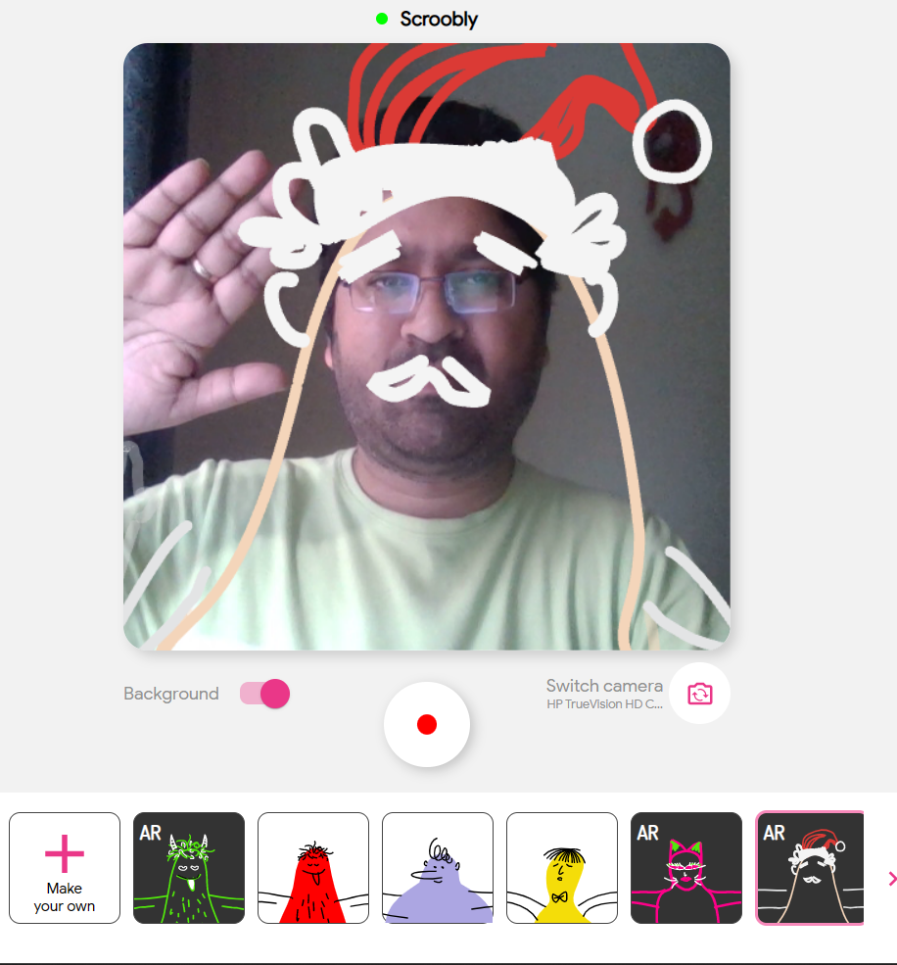
2.1 Data Science Use Cases (DSUCs):
Use Case: 2:
Scroobly - Scrooble a doodle. Bring it to life.

Slide 2
2.1 Data Science Use Cases (DSUCs):
Use Case: 3
Experiments in Handwriting with a Neural Network (distill.pub)

Slide 3
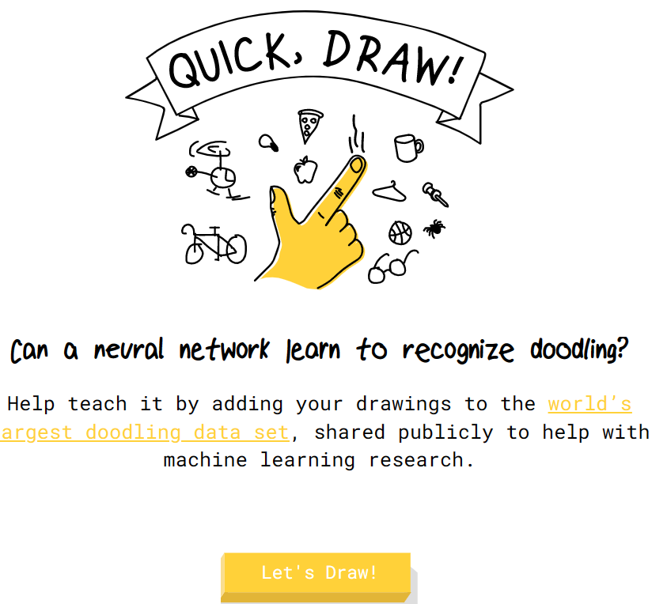
Data Science Use Cases (DSUCs):
Use Case: 4
Quick, Draw! (quickdraw.withgoogle.com)

Slide 4

2.1 Data Science Use Cases (DSUCs):
Use Case: 5:
AutoDraw

